Slide 1
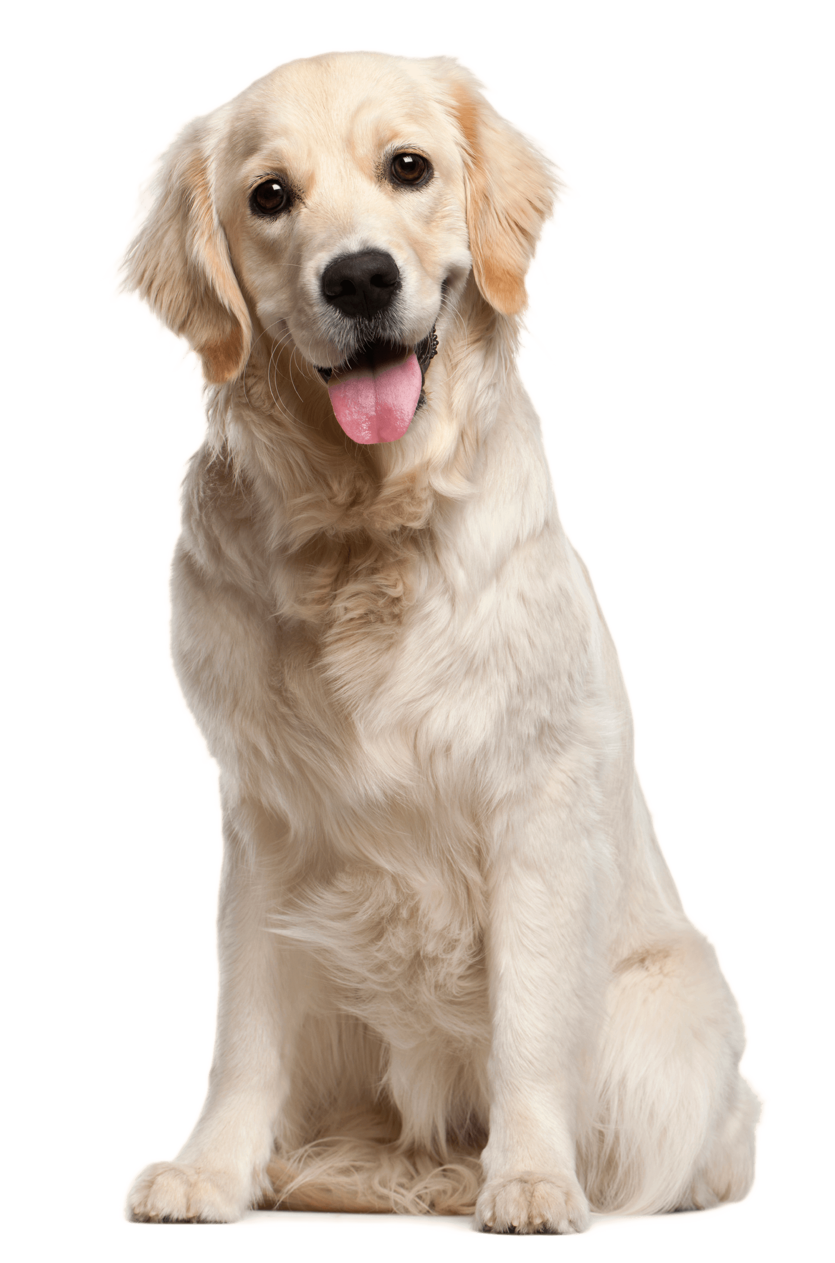
Pet Match
Diana Carrara
Jenn London
Justin Bregenzer
Rich Walker
Where pets become family.
Saving one pet will not change the world,
but surely for that one pet,
the world will change forever
Notes:
Justin

Slide 2
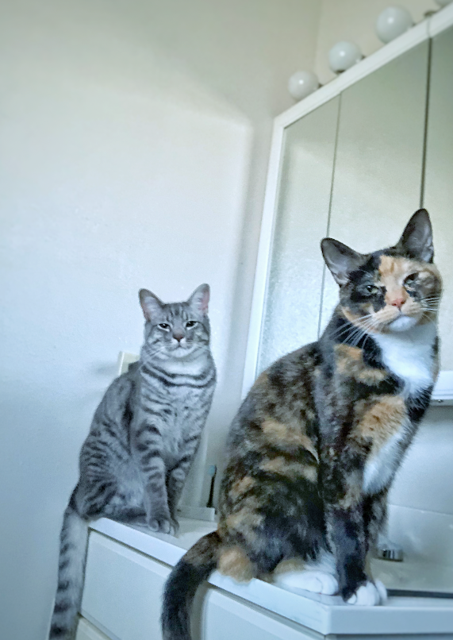
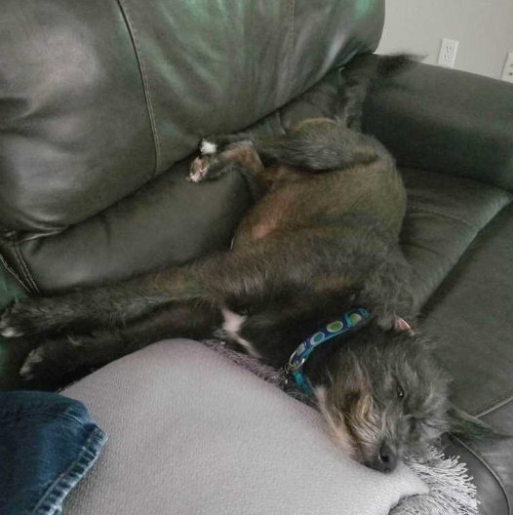
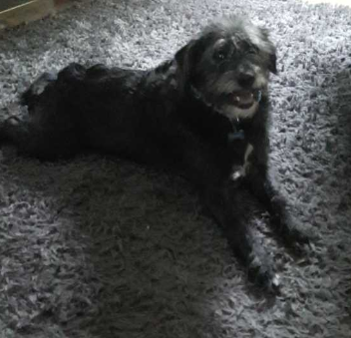
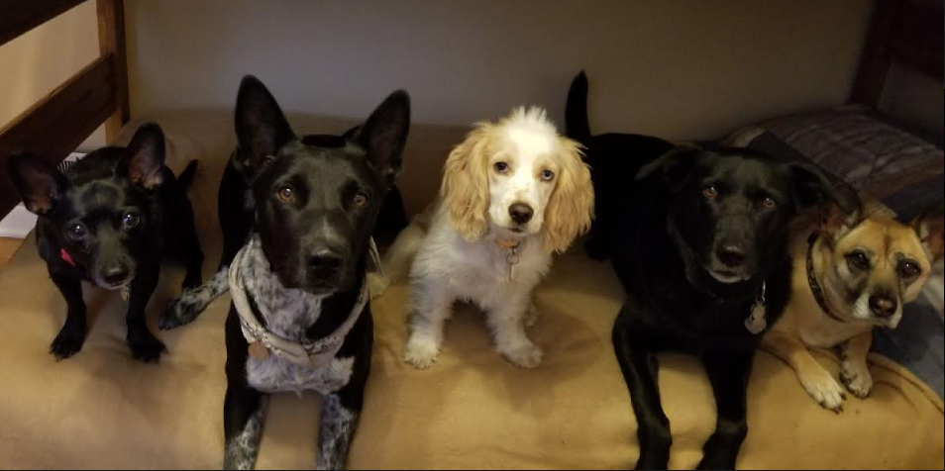
Our Inspiration
Notes:
Justin

Slide 3
Motivation
We all have a love for animals, especially Dogs and Cats.
We wanted to have a simple search tool to find our next companion and their location.
Our Project #1 concept was to start with linking an animal adoption repository to be able to search dogs and cats; providing location by utilizing google maps for an easy to use petMatch experience.
Notes:
Justin

Slide 4
MVP minimum viable product
Provide clean and easy to use user interface for searching petFinder data, know animals location, and contact for possible visit and adoption.
Utilize a new library, Bulma
Link to our main data source repository (PetFinder)
Link to mapping service (googleMaps)
Obtain the data via .ajax
We ended up using Axios, very similar json adaptor
Notes:
Justin

Slide 5
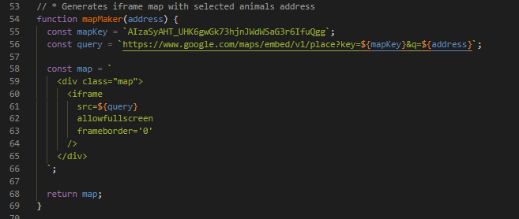
API
<script src="https://unpkg.com/@petfinder/petfinder-js/dist/petfinder.min.js"></script>
Petfinder
Petfinder is dedicated to helping pets find homes, and we know you are too. Petfinder's free API is another way we extend your reach to get pets adopted.
The API provides ready access to data for Petfinder's hundreds of thousands of adoptable pets and the organizations that care for them.
Google Maps
Notes:
Rich

Slide 6
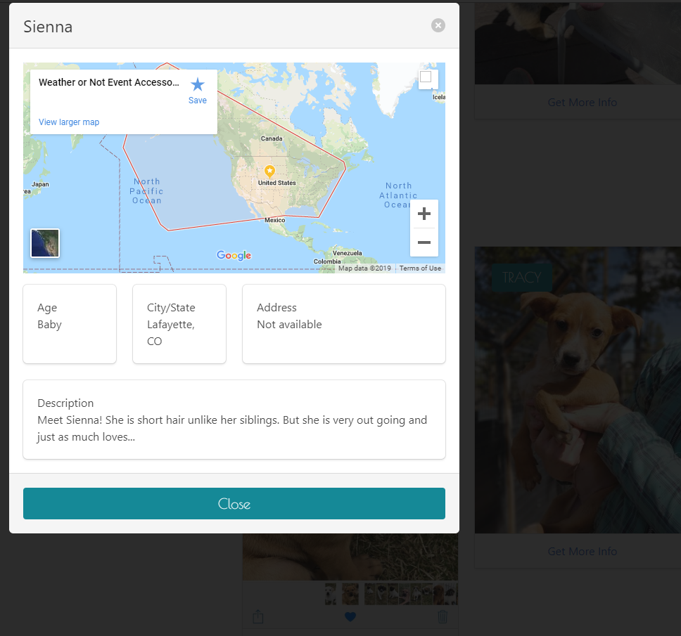
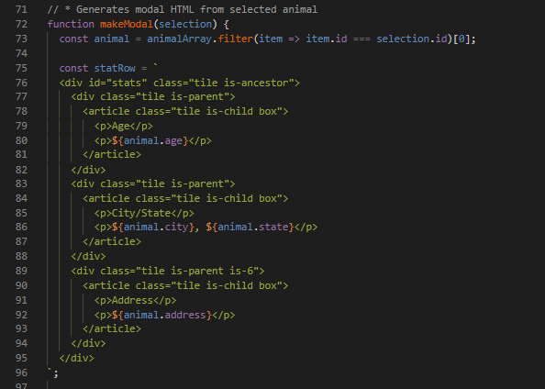
Technologies
Bulma
Modals – single window for individual animal review
Wrote the html into the jQuery .js
<link rel="stylesheet“ href="https://cdnjs.cloudflare.com/ajax/libs/bulma/0.7.4/css/bulma.min.css"/>
Notes:
Rich

Slide 7
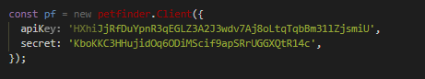
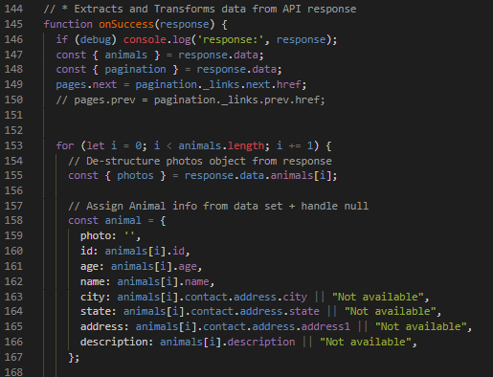
https://www.quora.com/Is-Axios-a-good-replacement-for-Ajax-to-make-HTTP-calls
ajax – Axios
Axios is a promise based HTTP request library / client. It does use 'Ajax' technology since it is using XML – Http requests internally.
Technologies
<script src="https://cdnjs.cloudflare.com/ajax/libs/axios/0.18.0/axios.min.js"></script>
Notes:
Rich

Slide 8
Technologies
js
Favicon
<script src="https://ajax.googleapis.com/ajax/libs/jquery/3.1.1/jquery.min.js">
<link rel="icon" type="image/png" href="./assets/images/favicon.png" />
Notes:
Rich

Slide 9
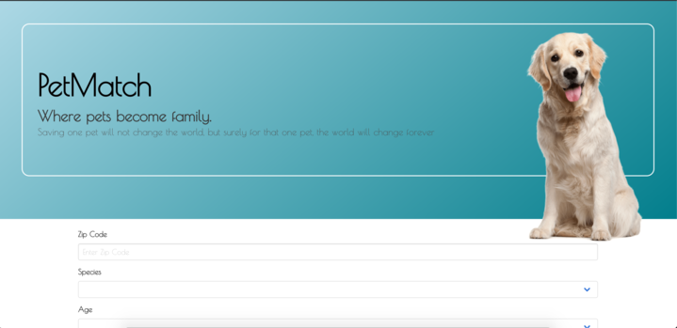
PetMatch Concept webSite
https://jennlondon15.github.io/GroupProjectAwesome/
Notes:
Diana

Slide 10
Future Development
Cat / Dog Giphy in place of static photo
Increase animal offerings to include Lion, Tigers and Bears… Oh My!!!
Provide a Tinder swipe ability app for portable users to adopt all animals in chosen proximity from your phone GPS location
We would like to provide a focused coupons and sales offering for pets products from Discount API for the users specific location.
https://discountapi.com/
Notes:
Jenn

Slide 11

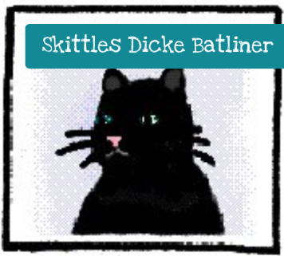
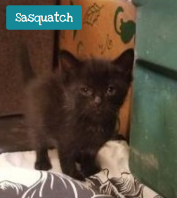
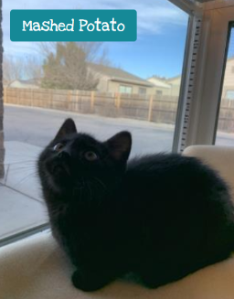
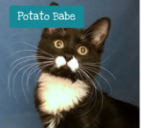
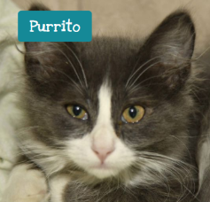
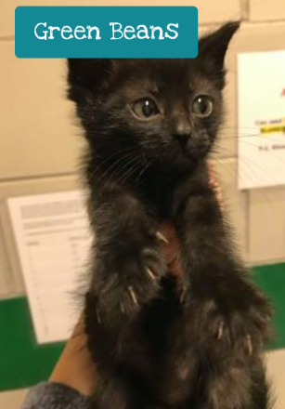
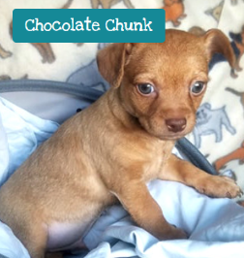
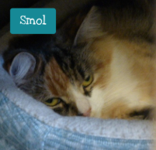
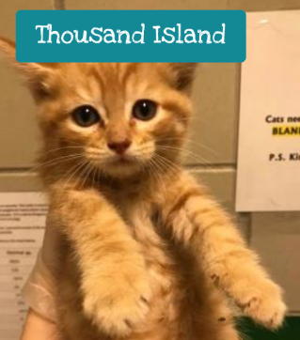
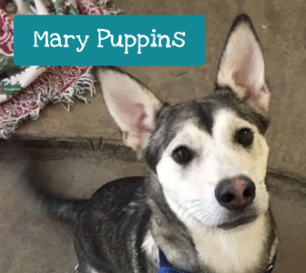
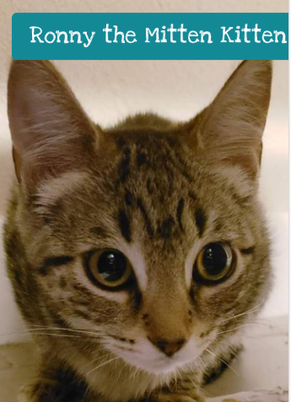
Thank You
Who is your perfect petMatch
Notes:
Jenn

